Slide 1
Present Simple
Present Continuous
1. A regular repeated action, often with an adverb of frequency
I often go to the swimming pool in the mornings
2. A permanent situation; facts
The sun rises in the east I work for St George’s Academy
3. Spoken instructions and processes
Turn left and go straight on Put your money in and press the button
4. With stative verbs
I love you! I can’t believe it!
1. An action happening at this exact time
I am teaching this English class Yeray is listening
2. A temporary situation happening around now
I am learning Basque

Slide 2
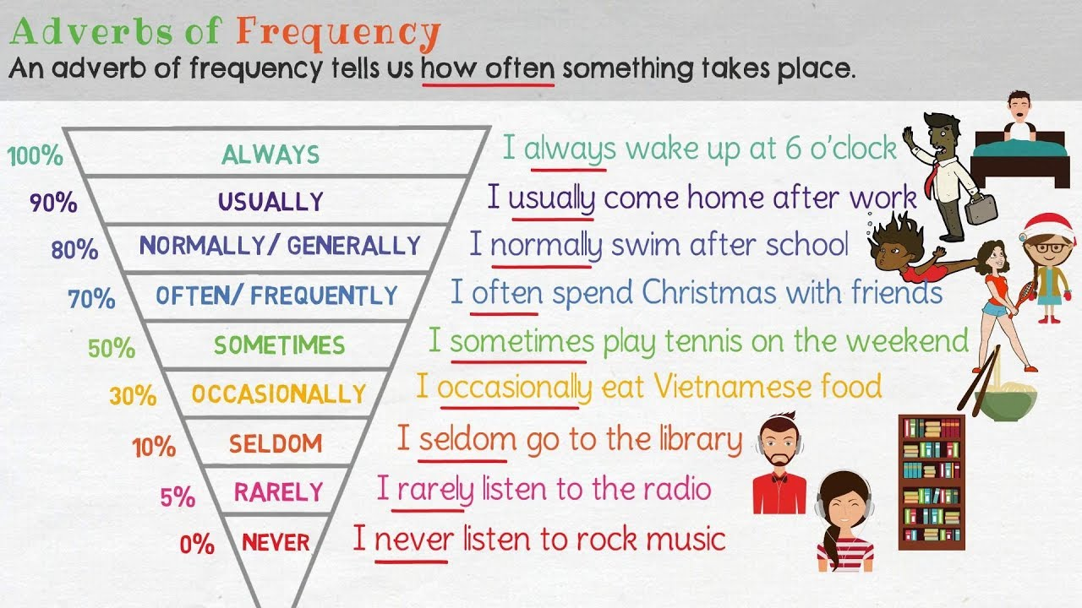
Adverbs of Frequency
MOST OF THE TIME
HARDLY EVER

Slide 3
Adverbs of Frequency
They usually come:
after the auxiliary verb: I have always liked chocolates
after the verb ‘to be’: He is occasionally late
before all other verbs: I never ride a bike to school
Longer adverbial phrases come at the end of the clause: I go to rugby twice a week
Sometimes, often and occasionally can come at the beginning or end of a clause in spoken English: I go to the supermarket often
Test yourselves!

Slide 4
Stative verbs
Stative verbs: for something you feel or think. There is no physical action involved
Love, hate, like, feel, think, understand, believe, know
Usually used in Present Simple tense
Active verbs: for things that you do. There is an action involved
Run, swim , live, explain, cook…
Can be used in both Present Simple and Continuous

